Slide 1
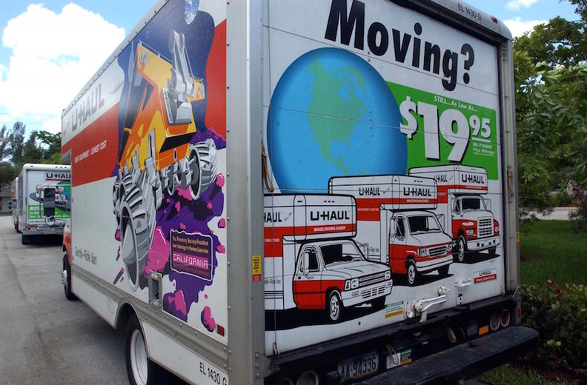
How to prevent Illinois Exodus?
- S M Nazarat Hossain

Slide 2
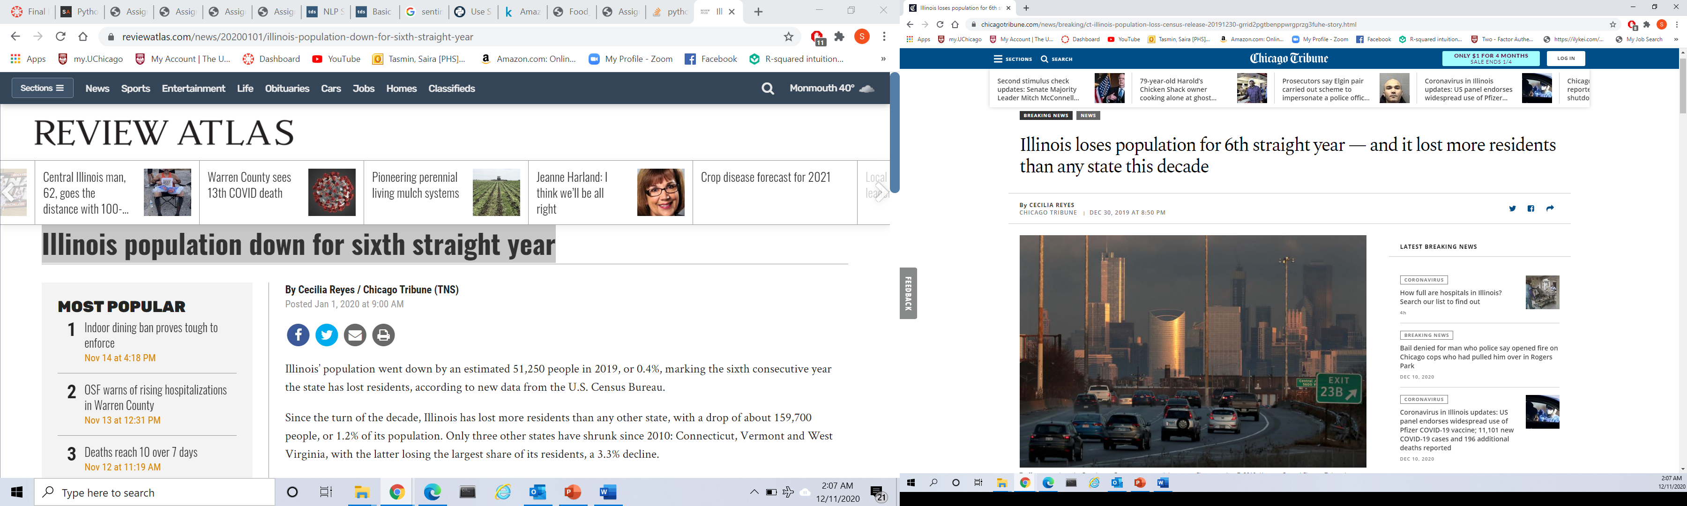
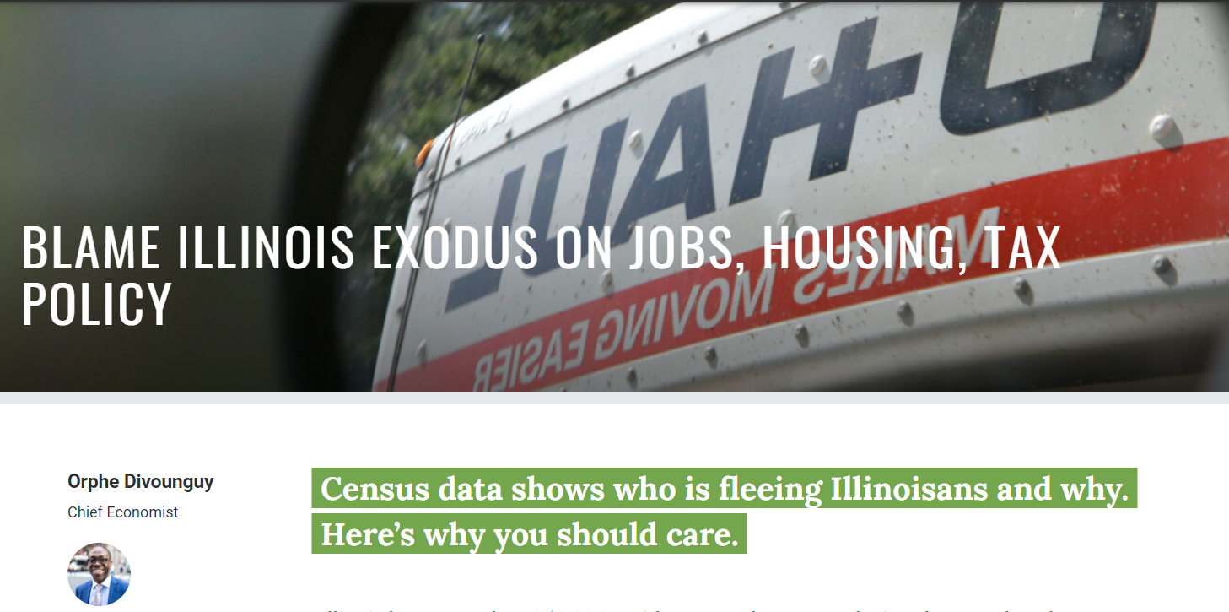
Executive Summary
background
Illinois is one of the main state and business hub in the USA. Big cities, attractive towns, growing economy, good school, lower living cost, great lake, farmland, and rivers are the highlights and attractions of the state for living.
problem
However, Illinois is famous for being one of the very few states in the country with negative population growth. In the past decade, it lost more than 850,000 residents to other states, causing the state’s population to shrink for six consecutive years. Therefore, it has become an immediate necessity to halt the migration of people.
Project Goal
Identify the key reasons by extracting meaningful insights from unstructured text and provide actionable recommendations on what can be done to reverse this declining population trend
Notes:
Number of registered recreational boating vessels in the U.S. from 2000 to 2018
(in millions)
Peak: 2005: 12.94 mil
Lowest:2014:11.8 mil
2018:11.85 mil

Slide 3
Data Overview and Methodology
Data Description:
Number of Articles: 337294 (Last 12 months)
Number of features: Date, Language, Text, and Title
Methodology
Sentiment Analysis with TextBlob
-> Identify the negative and positive news and articles
Sentiment Classification Analysis
-> Develop statistical model for classifying the news and articles as either positive or negative
Topic Analysis -- Word Cloud
-> Determine key words and topics, and visualize them
NER Analysis– Spcay
->Identify top person and organizations.
Topic Modeling – LDA Model
->Discovering hidden topical patterns that are present across the news and articles.
Use Text and Title of news/articles for analysis
Data Preprocessing:
Summarize text
Data Cleaning:
Lowercases all text.
Removes all accents from strings.
Removes all stop words.
Removes all blocks of digits.
Removes all string.punctuation
Replaces unassigned values with empty spaces.
Removes all white space between words

Slide 4
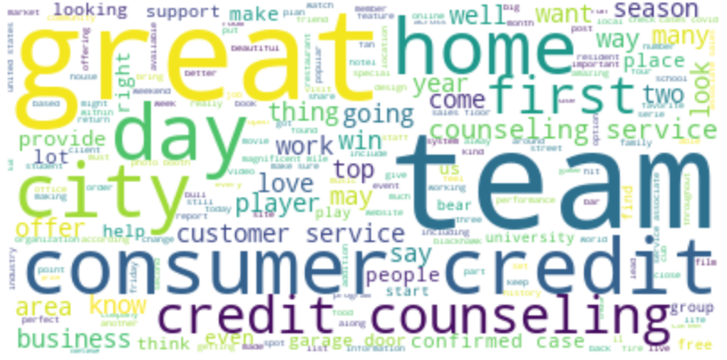
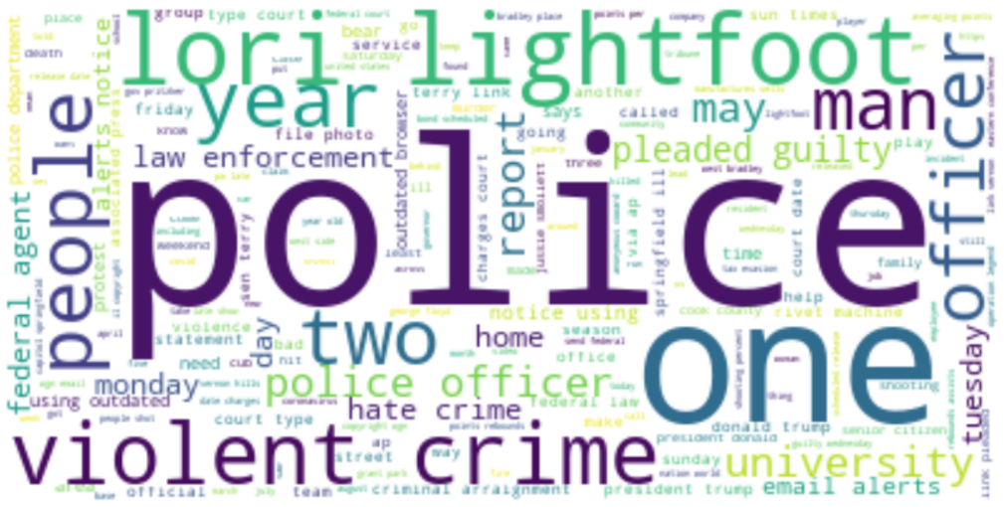
Sentiment Analysis and Classification
Sentiment Analysis with TextBlob
Sentiment Classification
Sentiment Level | Total Counts | (%)
Very Positive | 1,402 | 0.4
Positive | 17,861 | 5.3
Neutral | 314,488 | 93.3
Negative | 3,325 | 1.0
Very Negative | 218 | 0.0
Statistical Model | Accuracy
Naive Bayes Model | 84%
Logistic Regression Model | 84.1%
Support Vector Machine | 84.1%
Logistic Regression Model and SVM perform well for classification of sentiment level (Positive or Negative)
Positive (5.7%) news/article are much higher than negative (1%) news/article
Topic Analysis – Word Cloud
Positive Keywords:
Negative Keywords:
‘Great City/Home’, ‘Team (Chicago Cubs, Chicago Bears, Chicago Bulls)’, ‘Business’, ‘Customer Service’, ‘Credit’
‘Police’, ‘Violent’, ‘Crime’, ‘Guilty’, ‘Hate Crime’, ‘law enforcement’

Slide 5
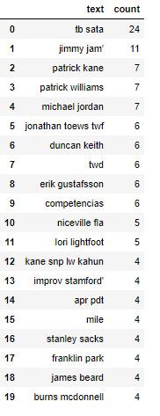
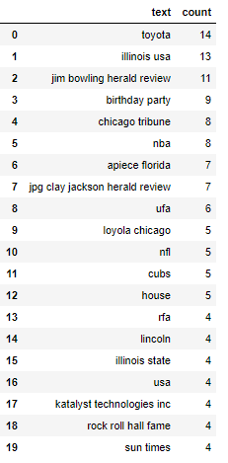
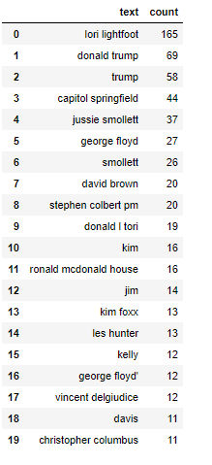
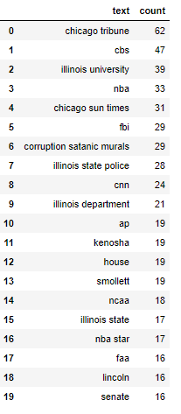
NER Analysis using Spcay
Top Positive Person
Top Positive Organization
Top Negative Person
Top Negative Organization

Slide 6
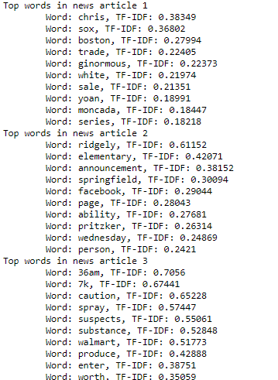
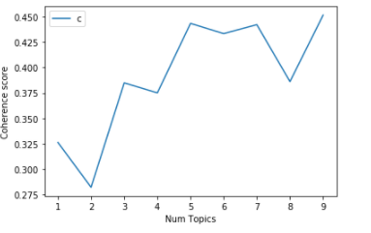
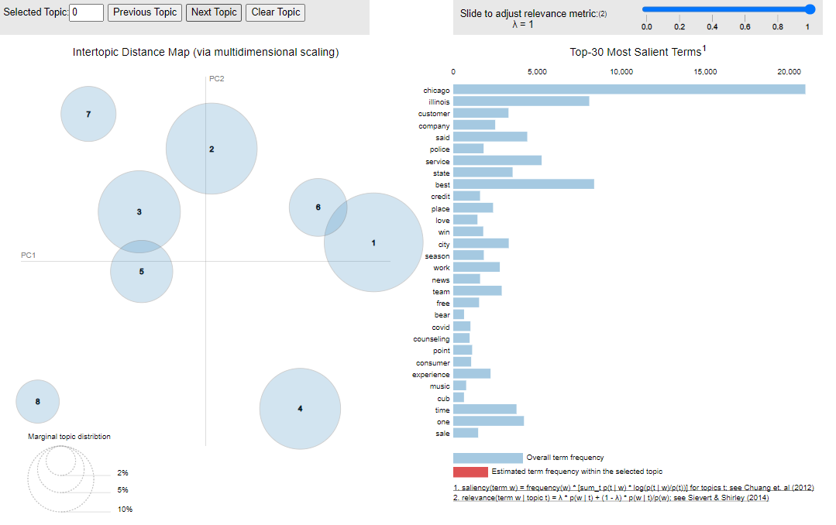
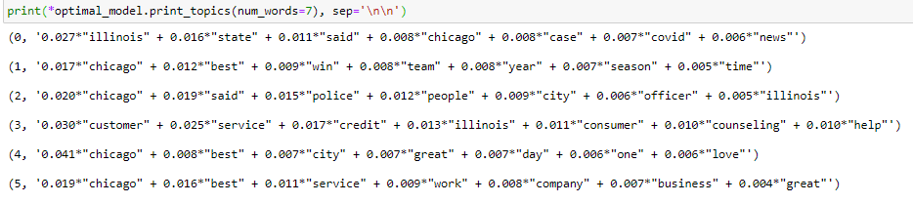
Topic Modeling
Visualizing topics as distributions over words (Model 7)
TF-IDF
Topic Coherence Score
Based on the topic coherence score and less overlapping, model 7 is the best suitable model for discovering the abstract “topics”.

Slide 7
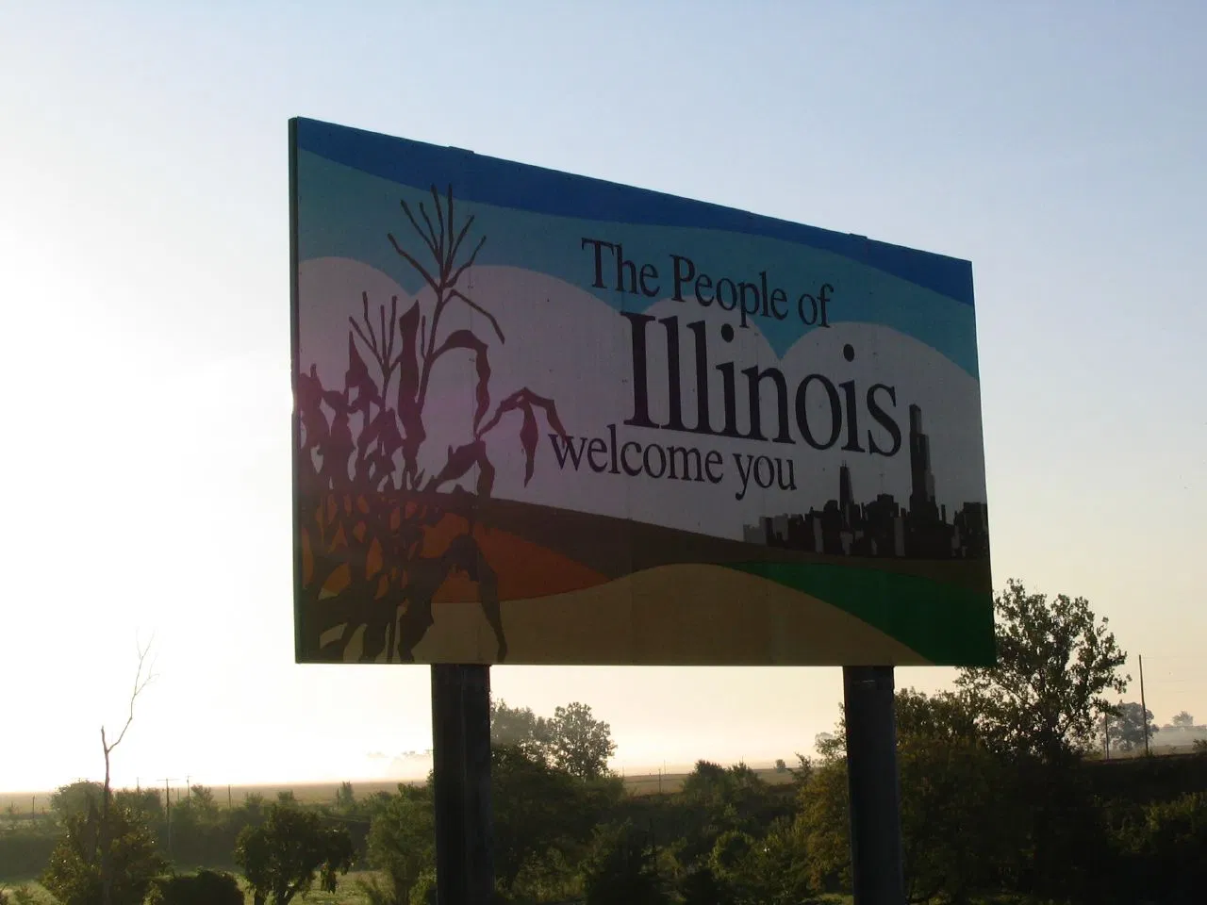
Actionable Recommendations
Violation, crime, hate crime, shooting and some other related topics are the concerns of the population of Illinois.
Law enforcement organization/police should be more active to reduce violence and ensure safety
Higher tax is an reason for leaving Illinois.
State/City should consider the issue
Great city, Chicago sports teams, jobs, businesses and services are main attractions for living in Illinois.
State/City should promote them
Proposed Logistic Regression Model, Support Vector, Machine, and LDA Model can be used for discovering hidden topical patterns in future
Publicize top 20 persons and organizations to attract people to stay in Illinois

